Slide 2
Photo courtesy of upyernoz (@Wikipedia.com) granted under creative commons licence; attribution

Slide 3
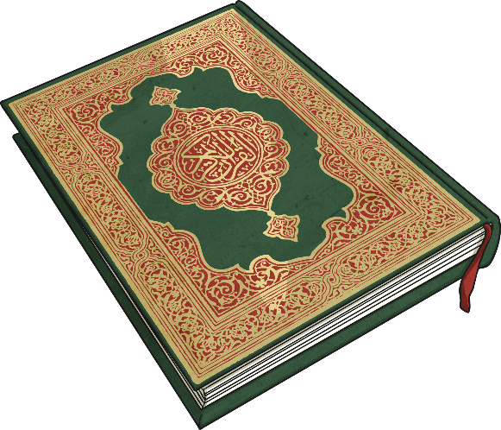
When Is Ramadan Observed?
Ramadan is in the ninth month of the Islamic lunar calendar. The Islamic calendar is based on the Moon rather than the Sun, although it has 12 months like the Western calendar.
Some Muslims believe the beginnings of the Qur'an were first revealed to the prophet Muhammad during this month. The actual night that the beginnings of the Qur'an were revealed is a night known as Lailut ul-Qadr ('The Night of Power’); Muhammad was told to learn the five verses by heart!

Slide 4
Photo courtesy of Bashar Al-Ba'noon (@Wikipedia.com) granted under creative commons licence; attribution

Slide 5
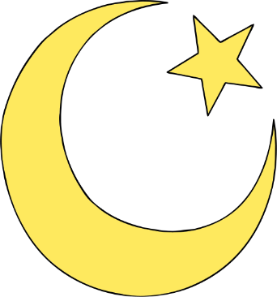
What Is Ramadan?
Ramadan is a very important time for Muslims; Ramadan is observed all over the world.
During Ramadan, Muslims request forgiveness for sins in the past, pray for direction and try to cleanse themselves through self-control and great acts of faith.
Restraint from everyday enjoyment is considered an act of obedience to God, as well as making amends for mistakes.
Ramadan is a time for Muslims to pray (salat) more
than normal.
It is a time of fasting for the Islamic people; Fasting
is one of the Five Pillars or duties of Islam.

Slide 6
Photo courtesy of DVIDSHUB (@Wikipedia.com) granted under creative commons licence; attribution

Slide 7
Observing Ramadan
Muslims try to give up bad habits during Ramadan, and some will try to become better Muslims by praying more or reading the Qur'an.
Many Muslims will attempt to read the whole of the Qur'an at least once during the Ramadan period. Many will also attend special services in mosques.
Fasting is intended to help teach Muslims to focus their attention on God, be self-disciplined and generous. It also reminds them of the suffering of the poor, who may rarely get to eat well. The prophet Muhammad set the example of fasting.
Each day during this month, Muslims all over the
world abstain from eating, drinking and other activities such
as watching television for too long, from dawn until the sun sets.

Slide 8
Photo courtesy of upyernoz (@Wikipedia.com) granted under creative commons licence; attribution

Slide 9
What Is It Like to Fast?
No eating or drinking during day-light hours.
Fasting begins very early in the morning. The morning meal is very filling. This meal is called Suhoor; high energy foods such as yogurts, cheese and honey are eaten. People slow down as the day goes on. At the end of the day after sunset the families all eat together and celebrate their day of fasting. This meal is called Iftar.

Slide 10
Photo courtesy of Raaid Majeed (@Wikipedia.com) granted under creative commons licence; attribution

Slide 11
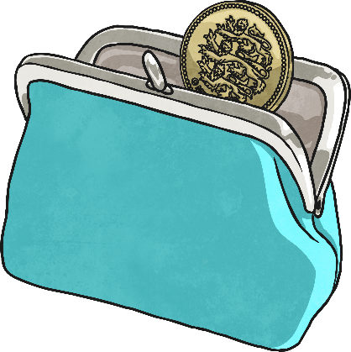
Fasting During Ramadan
Some people do not have to fast during Ramadan. These people can include:
people who are pregnant;
people who are travelling;
children younger than ten years old;
older people;
soldiers on active duty;
people who are unwell.
If Muslims are not able to fast, they sometimes donate money to help feed those who are poor. This is called Fidyah.

Slide 12
Eid al-Fitr
The end of Ramadan is a big celebration called 'Eid-al-Fitr’: Festival of the Breaking of the Fast.
Muslims celebrate the end of fasting and thank Allah (God) for the strength they believe He has given them throughout Ramadan.
There are special services, processions and a special celebratory meal eaten during daytime.
Muslims dress in their finest clothes, give gifts to children and spend time with their friends and family.
During Eid, it is obligatory to give money to charity to help poor people buy new clothes and food so that they too can celebrate.

Slide 13
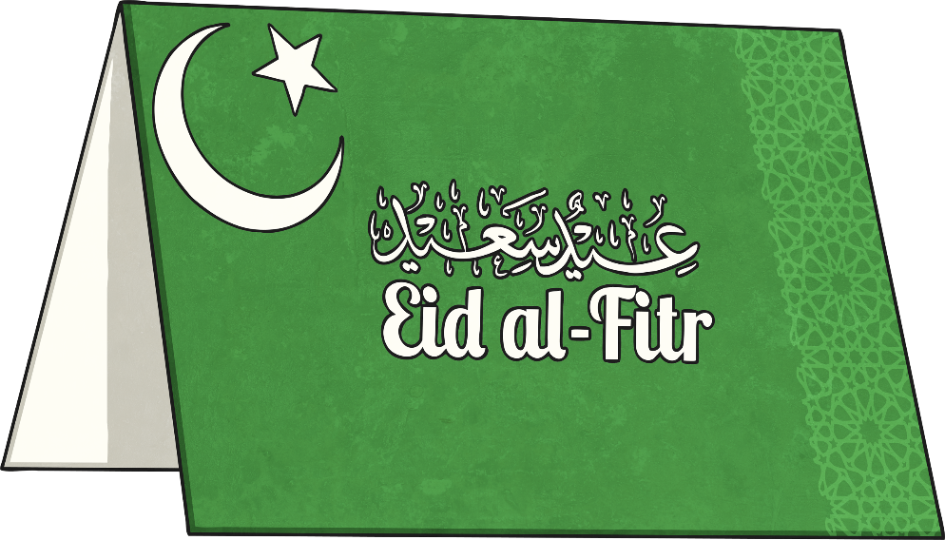
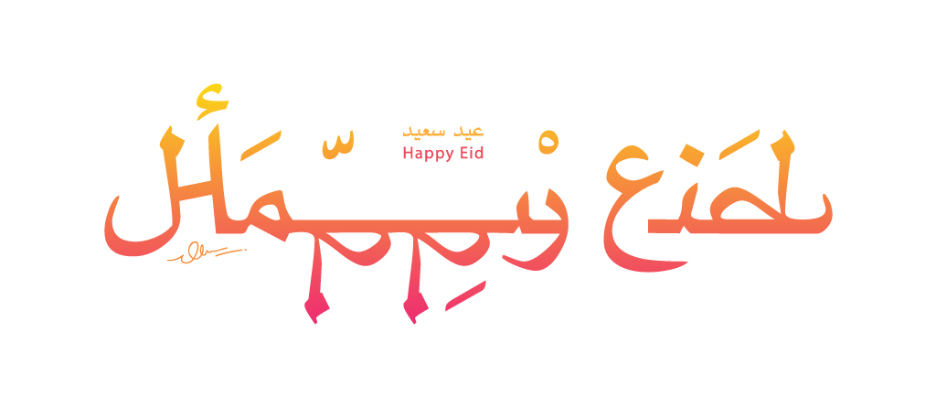
Photo courtesy of Sa'ad alGhamdi (@Wikipedia.com) granted under creative commons licence; attribution

